Slide 1
Government Procurement and Competition Policy - Anti-Corruption The Canadian Approach
John Brooks, ANJO Global Consulting Ltd
Ottawa, CANADA : jfbrooks@sympatico.ca
1-613-286-0541

Slide 2
SCOPE OF PRESENTATION
Buenos días
Canadian context
Canada’s federal public procurement
Default position:
Competitive procurement process
Competitive supply market
Competition optimised
Corruption minimised

Slide 3
Ten provinces: Alberta, British Columbia, Manitoba, New Brunswick, Newfoundland and Labrador, Nova Scotia, Ontario, Prince Edward Island, Quebec, and Saskatchewan
Three territories: Northwest Territories, Yukon, and Nunavut
Notes:
Canada is a federal monarchy – with the Queen of England as its head! Its structure though is the same as the other 27 federal states that includes he republics of, amongst others of: Mexico, Brazil and Argentina, USA and Venezuela.

Slide 4
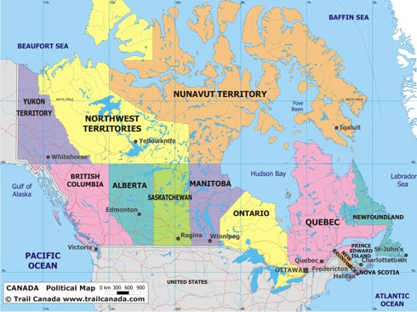

Slide 5
CANADIAN FACTS
Population (2012 est.): 34 Million
GDP = $1.839 Trillion (2013 est.)
GDP growth = 1.9% (2012 est.)
Member of the G7, G8, G20, NATO, NORAD, NAFTA, OECD, WTO/GPA, many bilateral trade agreements
Two official languages – English and French
Multi ethnic population
Notes:
Canada’s aboriginals (original inhabitants of Canada, before British, French colonisation) now represent some 3-4% of the total population – includes north American Indians (first peoples), Inuit (also known as Eskimo) and Metis (descendants of French/British settlers’ intermarriage with the first peoples). Note: Under Federal public procurement there is an Aboriginal ‘set aside’.

Slide 6
CANADA – three levels of government
Federal - responsible for issues that affect Canada as a whole country such as international relations, immigration, criminal law, taxes, national defence, and foreign policy.
Provincial - responsible for issues that affect the province as a whole such as education, health care, the environment, agriculture, and highways.
Municipal – responsible for community issues such as public parks, libraries, social services, local police and fire services, garbage removal, recycling, and public transportation.
Notes:
There is a Federal (national) police force (RCMP), which can provide local policing services, for pay, in certain provinces and municipalities. Provinces are responsible for natural resources. There is an Agreement on Internal Trade which affects a number of areas including procurement. AIT basically says that provinces will not discriminate against suppliers from outside their jurisdiction.

Slide 7
INTERNATIONAL INDICES
Doing Business – 17th of 183 economies
Competitiveness – 14th of 148 countries
Transparency - 9th of 174 countries

Slide 8
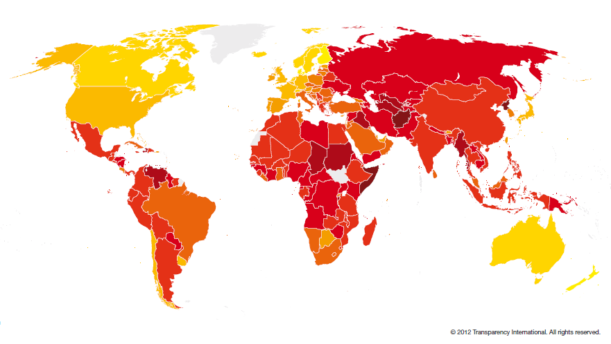
CORRUPTIONS PERCEPTION INDEX 2012
Source: Transparency International report – 2012)
Notes:
There are exceptions within Canada currently coming to light with evidence of major corruption for Quebec municipal government infrastructure contracts. Plus a major Canadian construction company SNC Lavalin, is currently under investigation for corrupt practices both in Canada and overseas.

Slide 9
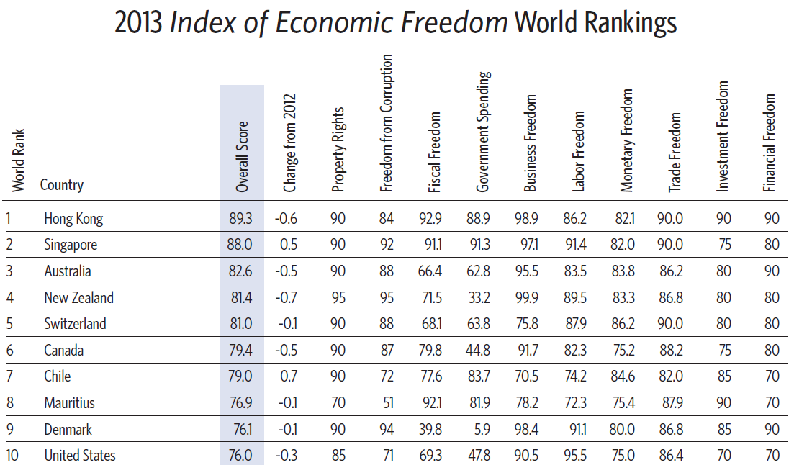
Notes:
In Canada government involvement is primarily limited to regulatory and not participation on the market as an operator. Exceptions are sea and airports, canals, etc.

Slide 10
Notes:
A free press is an essential element for monitoring the effectiveness of all government activities, including public procurement

Slide 11
Canada’s Economy
Service industries - transportation, education, health care, construction, banking, communications, retail services, tourism and government. More than 75% of working Canadians now have jobs in service industries.
Manufacturing industries - paper, high technology equipment, aerospace technology, automobiles, machinery, food, clothing and many other goods.
Natural resources industries - forestry, fishing, agriculture, mining and energy. A large percentage of Canada’s exports are natural resources commodities.

Slide 12
PUBLIC PROCUREMENT
National – composite data not available
Based on 10-15% of GDP ($CAD 1.839 trillion) – national public procurement
estimated to be:
$CAD 18-27 billion
(Federal $CAD 16 billion/yr)
Notes:
Note that $US and $CAD fluctuates close to par

Slide 13
FEDERAL PROCUREMENT
Annual spend of $CAD 16 billion/yr
Public Works & Government Services Canada (PWGSC)
Central procurement agent for approx. 140 MDAs
MDAs have delegated authority for some purchases
Pooled procurement with other levels of government
Limited common purchases with provinces
Some interprovincial pooled procurement
MDA = Ministries, Departments and Agencies
Notes:
MDAs generally have up to $25K for goods and up to $2M for services. Also, they use common procurement tools put in place by PWGSC (standing offers and supply arrangements). There is very limited pooled procurement. One exception is certain drugs and medications such as Influenza vaccine (annual and pandemic) which is bought by the feds for all jurisdictions. There is little consolidation of purchases between the federal and provincial levels of government. There is some consolidation between provinces the most notable just in the process of being introduced relates to the consolidation of medical supplies and pharmaceuticals.

Slide 14
FEDERAL PUBLIC PROCUREMENT IN CANADA
Fair supply market
Fair procurement
Competition
Promoting effective competition between suppliers
Preventing collusion between suppliers
Anti-corruption
Ensuring the integrity of the public procurement process
Limiting the potential abuses by government stakeholders
Notes:
The federal government of Canada has two roles to play in relation to federal procurement – (i) procurement is conducted under policies and practices that promote competition to the maximum extent within and environment that is open, fair, transparent and equitable. And (ii) to ensure the market is not distorted by non competitive activities.

Slide 15
PUBLIC PROCUREMENT – FRAMEWORK
Contract – Common law
Legislation - Acts:
Access to Information
Bankruptcy and Insolvency
Competition
Criminal Code
Conflict of Interest
Defence Production
Department of Justice
Department of Public Works & Government Services
rest Act
Notes:
Most of the legislation applies to both federal and provincial procurement. Highlight the rationalise for ‘Lobbyists’ – to control (semi license) those that conduct lobbying and their contacts with government staff.

Slide 16
Federal Procurement - Framework
Legislation (continued)
Federal Accountability Act
Financial Administration
Integrity
Lobbying
Official Languages
Privacy
Public Servants Disclosure Protection (whistleblower)
Policies/Regulations
Treasury Board Contracting Policy.
Government Contracts Regulations
Code of Conduct for Procurement
PWGSC Supply Manual
Notes:
Part of the framework consists of standard solicitation and contractual terms and conditions. Also, TB has a number of other policies that touch on procurement such as the policy on the use of acquisition cards, procurement review policy and the policy framework on the management of Assets and Acquired services/ The Supply Manual is very effective and complete – expand on this

Slide 17
FEDERAL PROCUREMENT FRAMEWORK
Trade agreements
WTO – Government Procurement Agreement
North American Free Trade Agreement (NAFTA)
Agreement on Internal Trade
Several Free Trade Agreements with countries
Applicability to public procurement
Notes:
Numerous trade agreements also exist in addition to those shown – see below. Most have provision for access to public procurement between the parties:
FTAs in Force
Canada - Panama - Brought into force: April 1, 2013
Canada - Jordan - Brought into force: October 1, 2012
Canada - Colombia - Brought into force: August 15, 2011
Canada - Peru - Brought into force: August 1, 2009
Canada - European Free Trade Association - Brought into force: July 1, 2009
Canada - Costa Rica - Brought into force: November 1, 2002
Canada - Chile - Brought into force: July 5, 1997
Canada - Israel - Brought into force: January 1, 1997
North American Free Trade Agreement (NAFTA) - Brought into force: January 1, 1994
Canada - U.S. Free Trade Agreement (CUSFTA) - Brought into force: January 1, 1989 (superseded by NAFTA, which includes Mexico)
FTAs - Negotiations Concluded
Canada - Honduras - Negotiations concluded: August 12, 2011
Ongoing FTA Negotiations
Canada - Caribbean Community (CARICOM)
Canada - Central America Four (CA4)
Canada - Dominican Republic
Canada - European Union: Comprehensive Economic and Trade Agreement (CETA) Negotiations
Canada - India
Canada - Japan
Canada - Korea
Canada - Morocco
Canada - Singapore
Canada - Trans-Pacific Partnership Negotiations
Canada - Turkey
Canada - Ukraine
Negotiations to Modernize the Canada-Costa Rica Free Trade Agreement

Slide 18
PROCUREMENT – BEST PRACTICES
Procurement planning
Publication of requirements - over $CAD 80K
Advance Contract Award Notice (ACAN)
Sole source purchases
Public opening – limited
Fairness Monitors
Notes:
If time allows - review selection and role of a fairness monitor (likely not used by many jurisdictions).
Explain why so little public opening
BAFO generally not used

Slide 19
PROCUREMENT – BEST PRACTICES
Rigorous internal approval/review process pre-award
Major procurements: political endorsement, not selection
Consolidated purchases & frame agreements: optimised
Debriefing of bidders
Publication of awards
Internal & External audit
Notes:
Treasury Board of Canada, is the ultimate approval body for very large value contracts – Cabinet ministers sit on the Board – however, the submission of a contract to seek final approval to commit funds, review the structure and risks of the deal and seeks endorsement of the award. TB does not address the selection of the contractor. Ancillary support from transparency can be obtained via the Freedom of Information Act (John H..what exactly can be examined).Also, civil servants have the protection under the ‘whistle-blower act’ should they wish to use this to report any wrongdoings.
Many small procurements for goods and services are made against pre-competed arrangements such as supply arrangements and standing offers. Part of the approval process involves strict control of delegated authority and that a procurement plan is part of the approval process and which occurs at the beginning of the process. Also, as part of the open process all procurements are open to a Q&A process which gives transparency to the solicitation and which often results in changes to the solicitation to ensure fairness and equity. Here is what PWGSC says about best practices: https://buyandsell.gc.ca/policy-and-guidelines/supply-manual/section/1/10/10 Basically everything is open to Access to Information process. The only thing that would be removed (redacted) would be information that is proprietary to a third party. Politicians endorse/approve projects and budgets and may direct procurement strategies but once the process is underway, they do not influence the procurement itself. The only thing they will do is provide approval of the recommended selection if the requirement is above the approval limits of bureaucrats ($20M for services and $40M for goods, in general for PWGSC). Very limited occasions where TB refused to accept the recommendation and picked another winner (e.g. Canadair in Montreal over Bristol in Winnipeg for aircraft repair)

Slide 20
SMALL & MEDIUM ENTERPRISES
No preferential treatment
Seeks to level the playing field
Ease of access to information, registrations
Elimination of minor fees
Provides advice/outreach/seminars
Links SMEs with ministries that provide grants, etc
Since 2007 - contracts awarded to SMEs
43% (by value) of contracts to Canadian contractors
Notes:
The Office of Small and Medium Enterprises (OSME) advocates on behalf of small and medium enterprises (SMEs) in federal procurement.
OSME improves SMEs access to government contract opportunities by reducing procurement barriers, simplifying the contracting process, providing advice to SMEs wishing to do business with the government, collaborating to improve procurement policies and best practices and working with SMEs to ensure their concerns are brought forward and heard. Since its creation, OSME has assisted over 53,000 individuals and suppliers through outreach seminars, trade shows, and meetings. In addition, since 2006-2007, PWGSC has awarded, on average, more than 43% of the total value of contracts transacted with businesses located in Canada to SMEs. OSME is committed to eliminating barriers to SME participation in federal procurement. The Government has eliminated the fees to access the system e-tender board so that suppliers can view and order all federal procurement opportunities at no cost.
Since 2007, PWGSC has made enhancements to the GETS/MERX

Slide 21
ABORIGINAL SET ASIDES
Mandatory set-asides
Aboriginal population - recipient of purchase
Best value must be assured
Voluntary set-asides
Where qualified Aboriginal suppliers exist
Best value must be assured
Notes:
The decision to set aside a procurement the responsibility of the procuring entity
There are two types of set-asides:
Mandatory Set-Asides:
It is mandatory to set aside a procurement under PSAB if an Aboriginal population is the primary recipient or end user of the goods or services being procured and the value exceeds $5,000, provided that operational requirements, prudence, probity, best value and sound contracting management can be assured.
In order for an Aboriginal population to be the primary recipient or end user of the goods or services being procured, delivery does not have to be directly to the Aboriginal community. For example, goods may be delivered to a government department site and later distributed to Aboriginal communities, groups or individuals. "Aboriginal Population" means
an area, or community in which Aboriginal people make up at least 80 percent of the population;
a group of people for whom the procurement is aimed in which Aboriginal people make up at least 80 percent of the group.
Voluntary Set-Asides: Client departments may designate any procurement as being restricted exclusively to qualified Aboriginal suppliers. Contracting officers should assist client departments in meeting their performance objectives under the program, by drawing their attention to opportunities for voluntary PSAB set-asides, when qualified Aboriginal suppliers are known to exist in the marketplace.

Slide 22
PROCUREMENT COMPLAINTS
Scope of purchases per year:
Estimated that 75,000 contracts issued
Total value $CAD 16 billion
Complaints to CITT 2011-12
53 contracts
Value estimated - $CAD 100 million
Complaints to Procurement Ombudsman 2012/3
3 contracts
Value – estimated $300K
Notes:
The most common award given by the Canadian International Trade Tribunal (CITT) is an amount to cover the cost of making the complaint. This is generally $1k up to $4K, depending upon the complexity of the case. The order can be for the government to pay the complainant, if the government was found to be at fault, or for the complainant to pay the government if the complaint was without foundation. Occasionally, the award may be to cover lost profits but these are more and more rare. In those cases, the firm is asked to estimate the lost profits and then there is a back and forth process to arrive at a number. Decisions of the CITT are appealable to the Federal Court. I can recall a few occasions where we did not agree with the CITT decision, which was obviously not in our favour, and we appealed the decision and the decision was reversed.

Slide 23
NON - COMPETITIVE ACTIONS
Cover bidding gives the impression of competitive bidding, but, in reality, suppliers agree to submit token bids that are usually too high.
Bid suppression or withdrawal is an agreement among suppliers either to abstain from bidding or to withdraw bids.
Bid rotation is a process whereby the preselected supplier submits the lowest bid on a systematic or rotating basis.
Market division is an agreement among suppliers not to compete in designated geographic regions or for specific customers.

Slide 24
NON-COMPETITIVE INDICATORS
There are few bidders in the market that offer the works, goods or services.
Price higher than in other jurisdictions/private sector
Two or more proposals contain similar handwriting, typos, or mathematical errors.
Over a series of awards, one bidder always wins, regardless of competition.

Slide 25
NON COMPETITION - PREVENTION
Special attention where few bidders
Allow for substitute products whenever possible
Develop alternative sources of supply
Have ‘in-house’ estimates
Require certification of compliance with legislation
High penalties for transgressors

Slide 26
PWGSC's Integrity Framework (1)
Applies to all PWGSC contracts including:
All values
Construction contracts;
Goods and services contracts
Real property transactions
Notes:
PWGSC seeks to ensure it does not deal with contractors that have been convicted of offences. Thus in addition to the fines or other penalties levied on the convicted, the supplier is also penalised by not being able to contract. John, I suppose this could be regarded as double jeopardy, especially as the contractor is banned forever. Have there ever been cases – CRG is one that comes to mind.

Slide 27
PWGSC's Integrity Framework (2)
A bidder is ineligible to do business with PWGSC with a conviction for:
Frauds against the government under the Criminal Code of Canada;
Frauds under the Financial Administration Act;
Payment of a contingency fee to a person governed by Lobbying Act;
Corruption, collusion, bid-rigging, etc under the Competition Act;
Money laundering;
Participation in activities of criminal organizations;
Income and excise tax evasion;
Bribing a foreign public official; and
Offences in relation to drug trafficking.

Slide 28
PWGSC's Integrity Framework (3)
The Integrity Framework is conviction-based and does not include discretionary provisions.
PWGSC does not apply its integrity framework to sub-contractors.
Some contracts stipulate that the contractor agrees to bind the subcontractor by the same conditions by which the contractor is bound

Slide 29
PWGSC's Integrity Framework (5)
No time limit on the ineligibility of convicted bidders
Convicted bidders will remain ineligible unless:
Have received a pardon (record suspension); or
Capacities were restored by the Governor in Council, or
Public Interest Exception applies

Slide 30
PWGSC's Integrity Framework (6)
The Public Interest Exception applies to convicted contractor but:
only one contractor is capable of performing the contract;
emergency;
national security;
health and safety; and
economic harm.
Exception applied on a case-by case basis
Contract subject to:
stringent controls
administrative measures and monitoring
Notes:
John, is this the only out for suspension?

Slide 31
PWGSC's Integrity Framework (7)
Conviction is post contract award, PWGSC may
terminate a contract or real property agreement for default if a conviction occurs post contract award,
or
may continue with the option and impose enhanced oversight and monitoring measures.

Slide 32
PWGSC's Integrity Framework (8)
PWGSC does not maintain a list of ineligible bidders.
Certification and verification are done for each bid
Bidders certify in bids free from convictions listed
PWGSC verifies the winning bidder’s eligibility
Notes:
In most cases PWGSC relies on the certification of the contractor and does not do an in depth verification

Slide 33
CANADIAN COMPETITION BUREAU
An independent law enforcement agency, ensures
that Canadian businesses and consumers prosper in
a competitive and innovative marketplace.

Slide 34
COMPETITION ACT - FOCUS
Civil and criminal penalties for:
Bid-rigging.
Conspiracies to lessen competition.
Price discrimination.
Price maintenance.
Refusal to supply.
Predatory pricing.
Mergers.
Abuse of dominance.
Tied selling.
Notes:
There have only been a few cases where the work of the Competition Bureaus has been related to suppliers to PWGSC (R. vs. Dowdall et al) for IT services is perhaps the most recent and is currently before the courts. Relate how the Competition Bureau would work with PWGSC after detection or suspicion of non competitive activities – relate this to John Holinsky’s input.

Slide 35
CANADIAN FEDERAL PROCUREMENT - EFFECTIVENESS
Spend of $CAD 16 billion/yr.
Estimated 75,000 contracts
Uses a well legislated and regulated process
Significant governance provided by related legislation
Transparency, openness & fairness
Acknowledged by stakeholders
Notes:
(i) The government policy and approach encourages competition to the greatest extent possible and has developed a process that is open, fair, transparent and equitable.
(ii) Policies, legislation, procedures are well described and universal
(iii) solicitations use standard approaches and methodologies
(iv) procurement strategies for each procurement are pre-approved
(v) Opportunities widely published
(vi) visible questions and answer processes are used during the bidding period
(vii) all bidders have an interest to keep an eye on what is happening in order to avoid being unfairly cut out of the process
(viii) limited delegations of authority
(vix) strict procedures for evaluation and selection of winners
(x) many people involved in the process (checks and balances, many levels of scrutiny and QC)
(xi) public announcement of winners
(xii) bidder debriefing
(xiv) there is a separation of duties and responsibilities (many people have their hand in the process)
(xv) procurement staff are independent and are trained and professional with a code of ethics that apply to them and to contractors
(xvi) the Ombudsman has the duty of monitoring the procurement processes and ensuring integrity and proper procedures (reports to Parliament annually) (xvii) the office of the Auditor General often looks in depth at various contracting situations to examine for fraud, errors, mismanagement, etc
(xviii) complaints, interjections, questions, etc. can be asked at any time of management or politicians
(xx) a formal complaint mechanism exists (CITT or Ombudsman)
(xxi) a judicial system exists which has and does consider complaints and contracting issues and does set precedents for future behaviour
(xxii) there is a very active press which is sensitive to contracting issues and is quick to report and expose (relocation contracts, for example)
(xxiii) access to information act facilitates openness
(xxiv) past contracting misadventures have had significant public exposure (sponsorship scandal)
(xxv) history and threat of public exposure helps keep participants in-line

Slide 36
CANADIAN FEDERAL PROCUREMENT - EFFECTIVENESS
Cadre of well qualified professionals in government
Effective separation of duties within government
Well ordered and educated supply market
High degree of prosecution certainty for transgressions
Significance of penalties for transgressions

Slide 37
Muchas Gracias – Thank you
John Brooks
ANJO Global Consulting Ltd
Ottawa, CANADA
jfbrooks@sympatico.ca
1-613-286-0541

